Slide 1
Dataanalyse
Bigrams and graphs

Slide 2
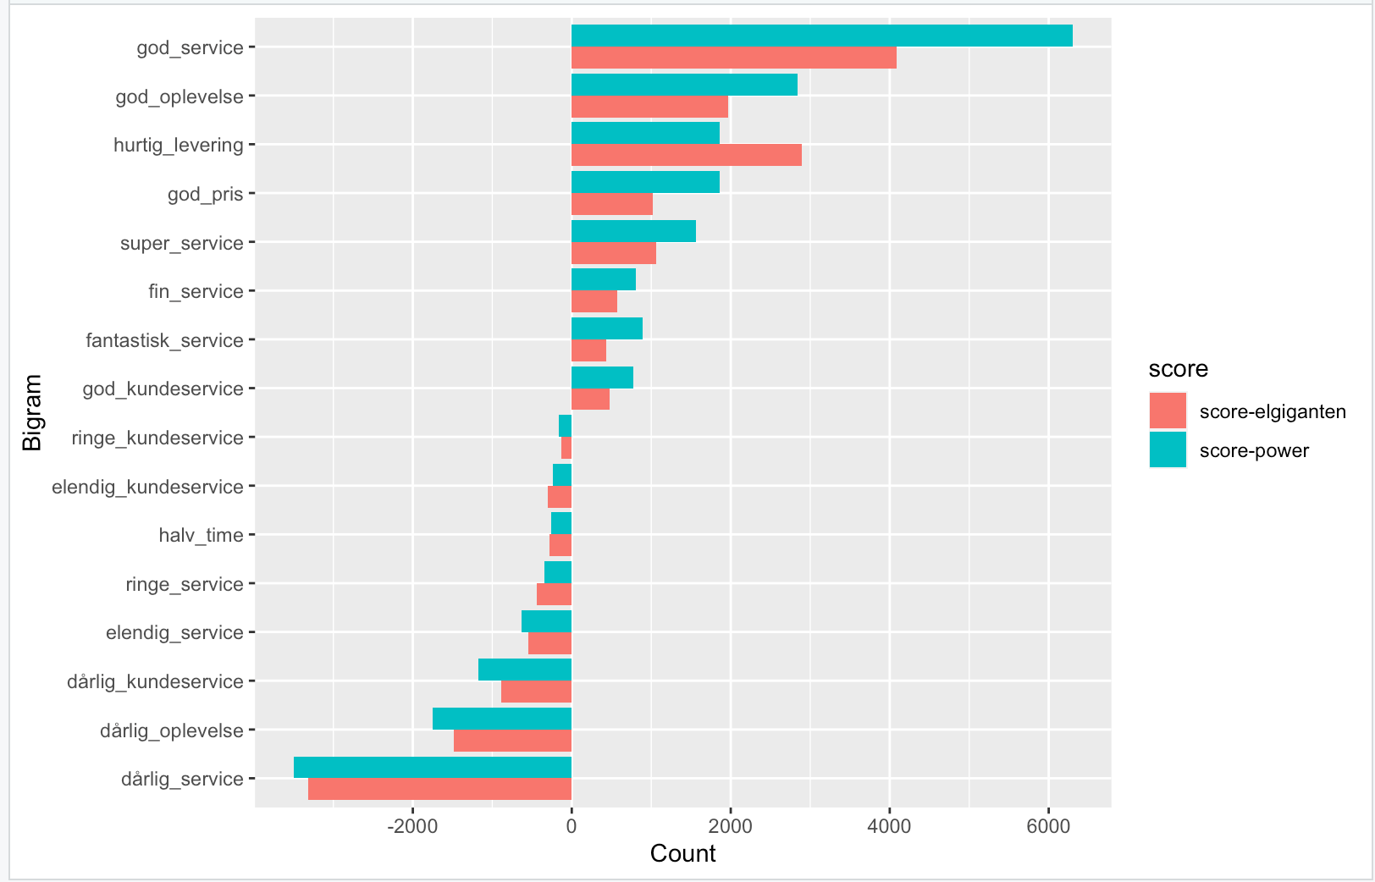
Agenda
Bigrams
Jane Austen
gender-analyse
Network
Eksamensleg I
Find en tekst fra gutenberg
Gennemgå trin
Opdel, optæl
Bigrams,separate,count,filter,viz
Eksamensleg II - Danske prædikener
Wordcount
Sentiment
Wordclouds
Silge og Danske Prædikener
Tag silges ”flow” og overfør til
HC-Andersen
Danske præster

Slide 3
Bigrams
Ord i kontekst

Slide 4
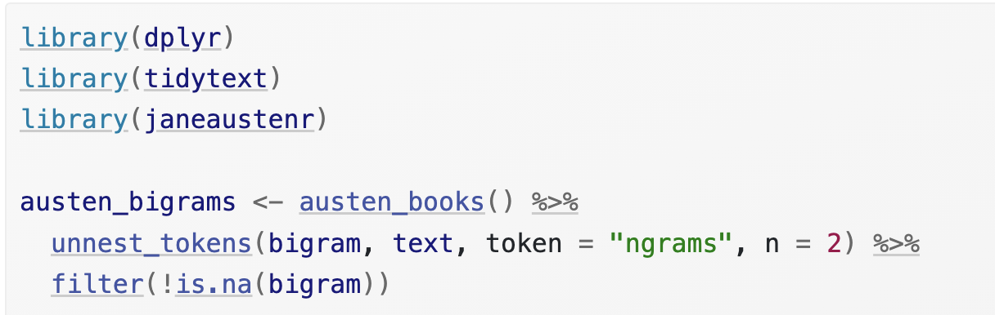
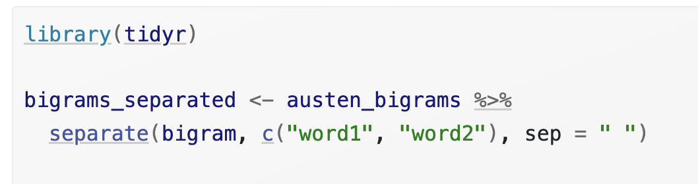
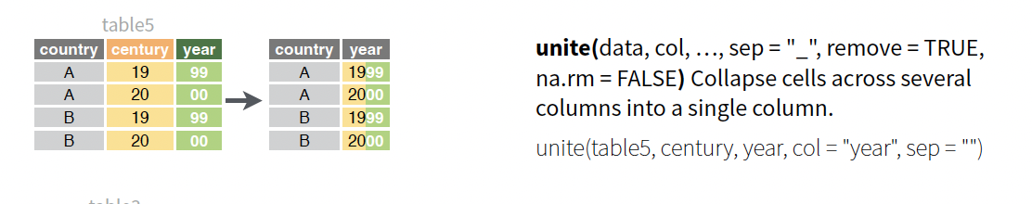
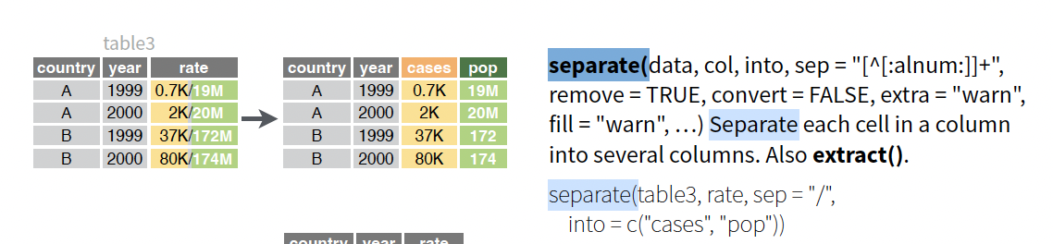
4.1.1 Counting and filtering n-grams

Slide 5
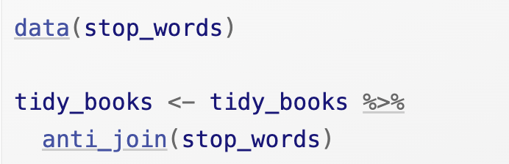
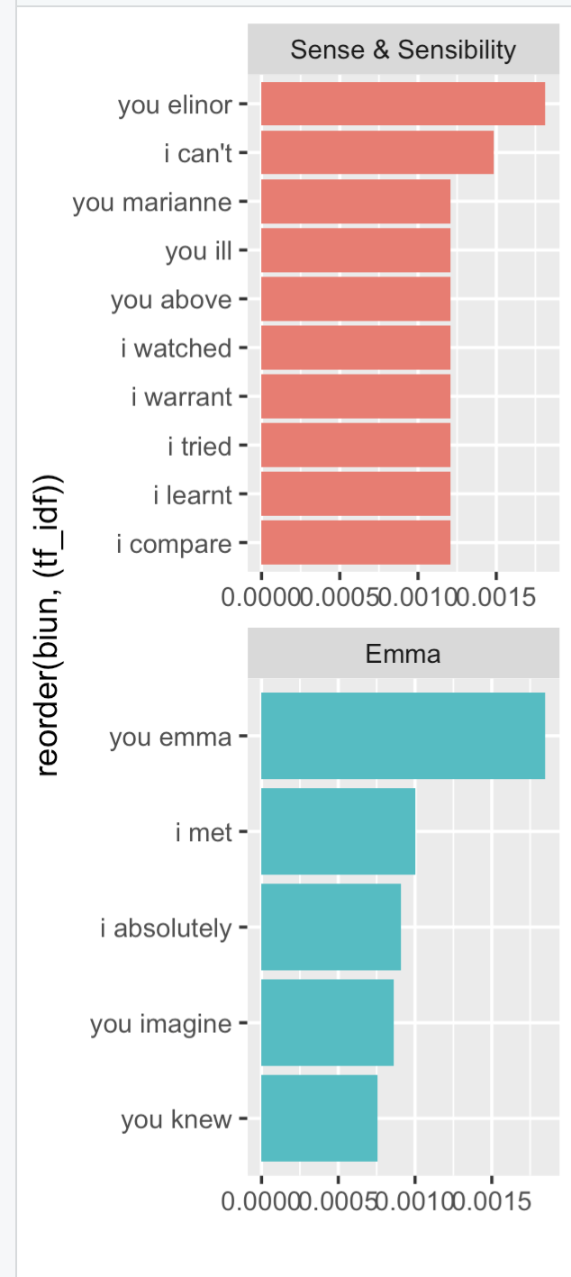
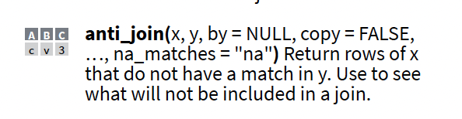
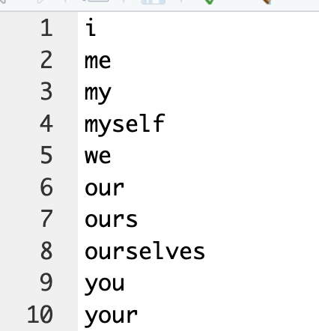
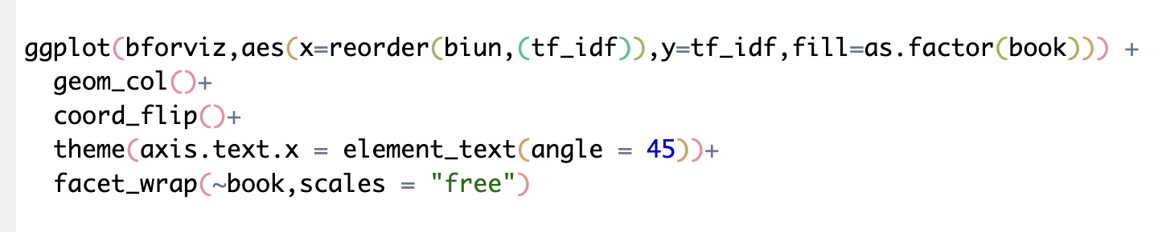
4.1.1 filtering and viz n-grams
Visualisér
Positiv liste
Negative liste

Slide 6
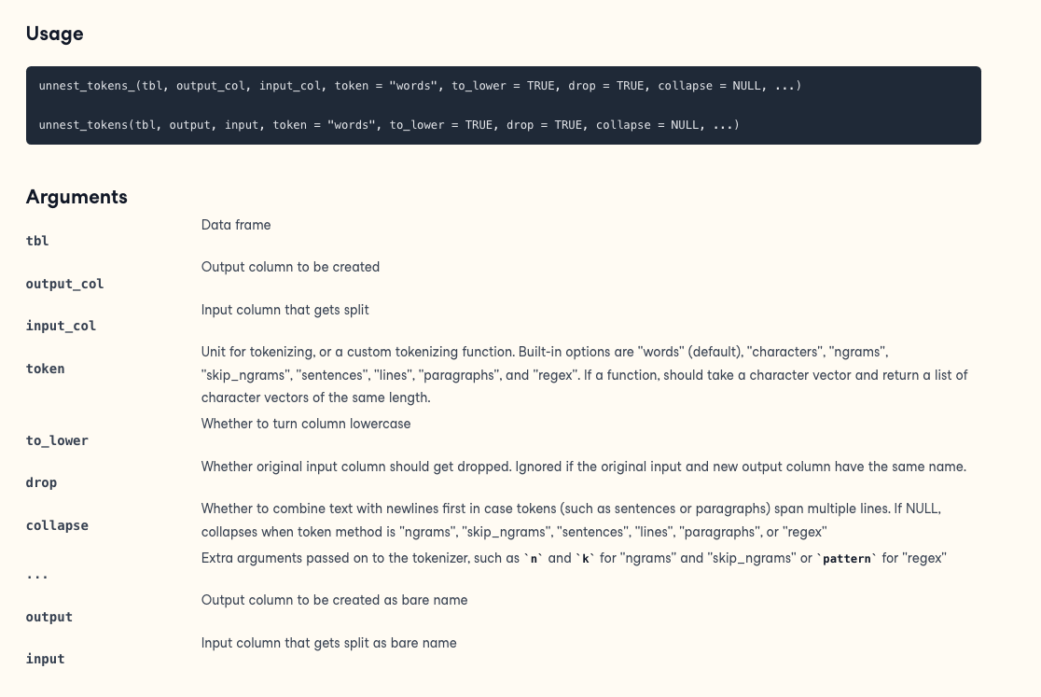
Unnest token

Slide 7
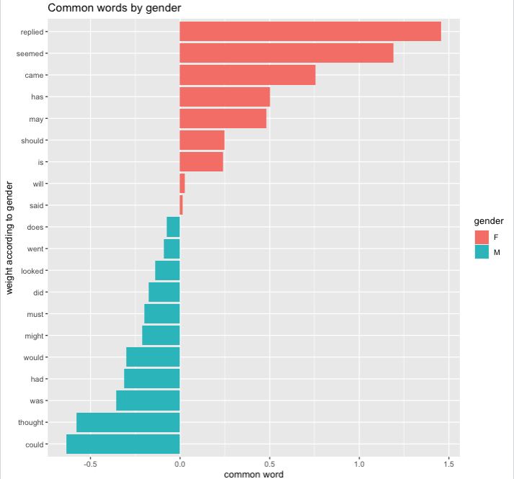
4.1.2 Analyzing bigrams
Hvilke verber anvendes hyppigst på hhv mænd og kvinder?

Slide 8
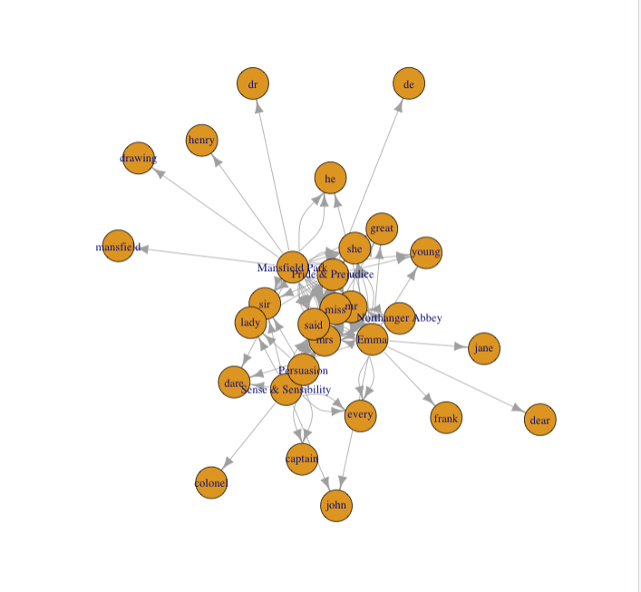
4.1.4 Visualizing a network of bigrams with ggraph
A graph can be constructed from a tidy object since it has three variables:
from: the node an edge is coming from
to: the node an edge is going towards
weight: A numeric value associated with each edge

Slide 9
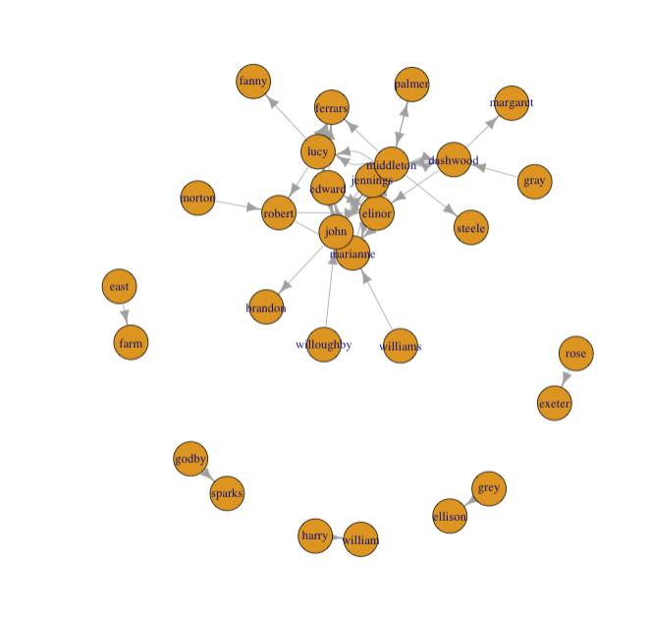
4.1.4 Visualizing a network of bigrams with ggraph
Opgave:
tokenize sætninger
Parse teksten med spacyr
filtrer alle personnavne pr sætning
find de sætninger hvor der er to personer
Illustrer netværket med en graf.

Slide 10
Silge on Sherlock Holmes
Sentiment

Slide 11
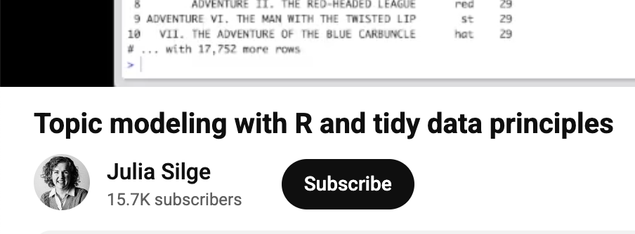
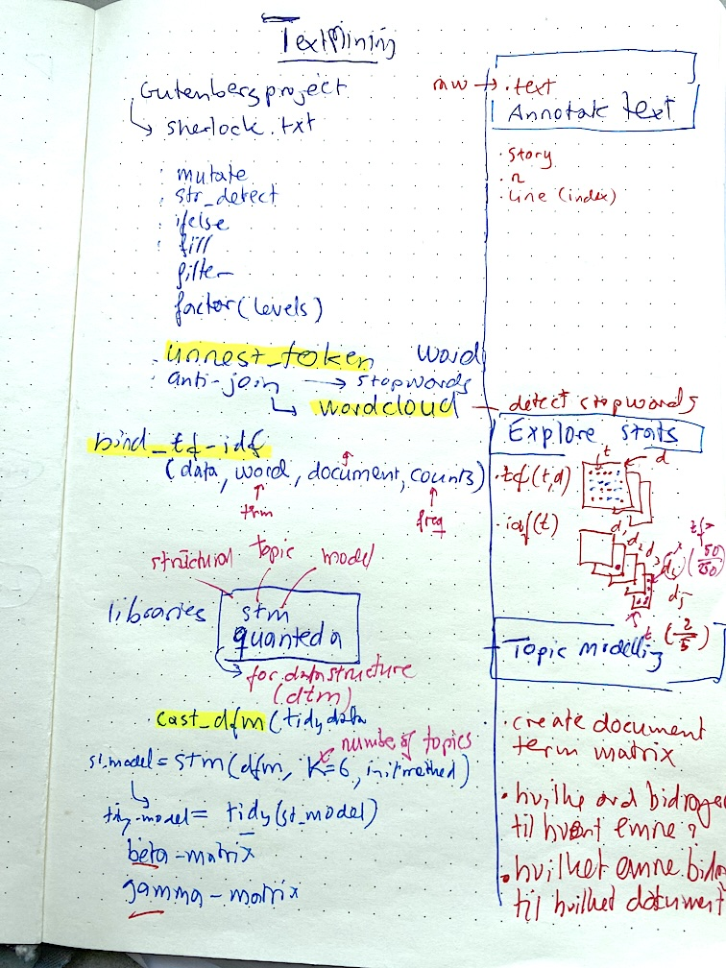
Annotate
Story, count
Explore
Td-idf
Topics
Dtm
tidy

Slide 12
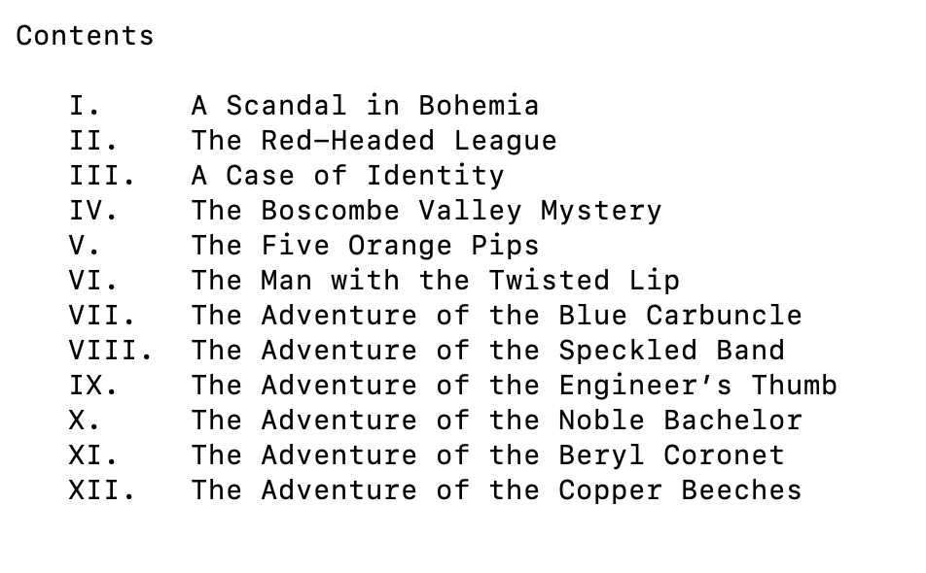
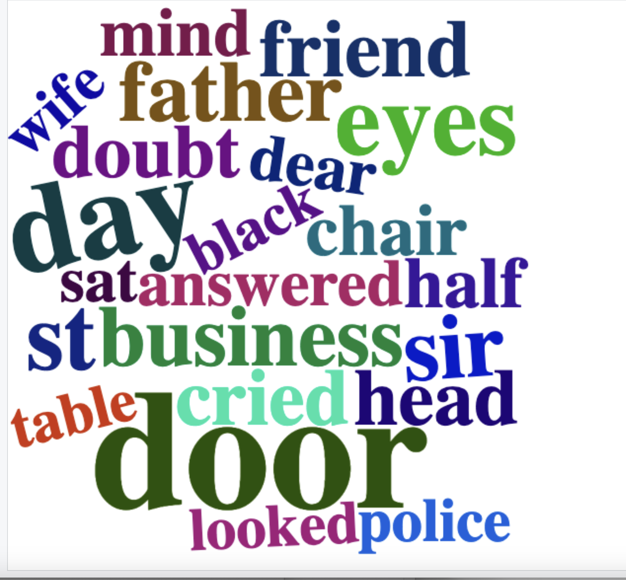
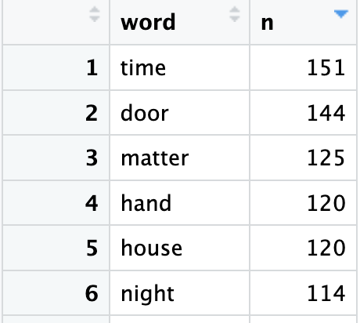
Tokenize and viz

Slide 13
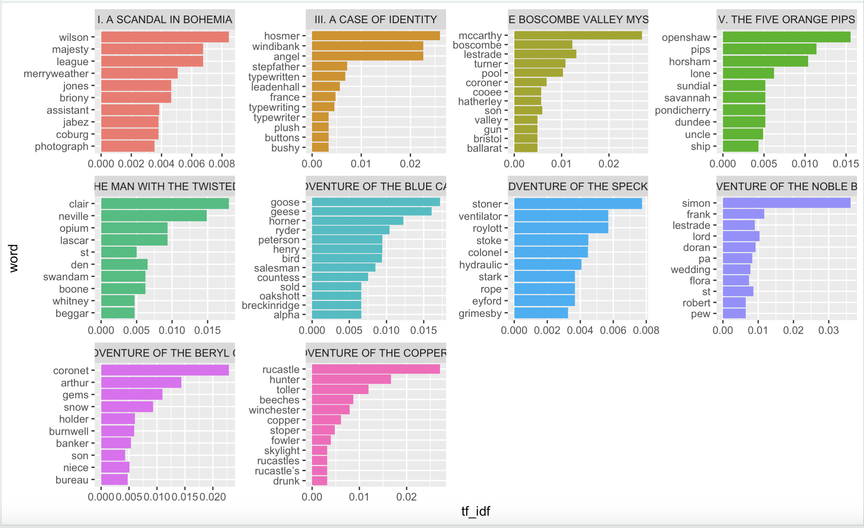
TF-IDF

Slide 14
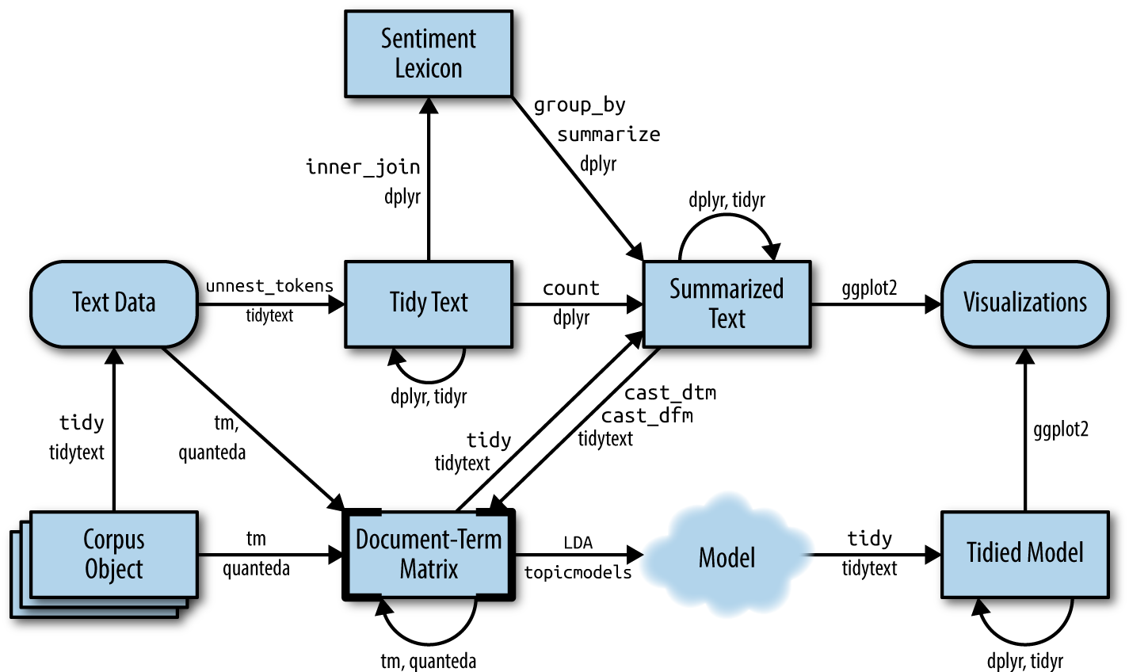
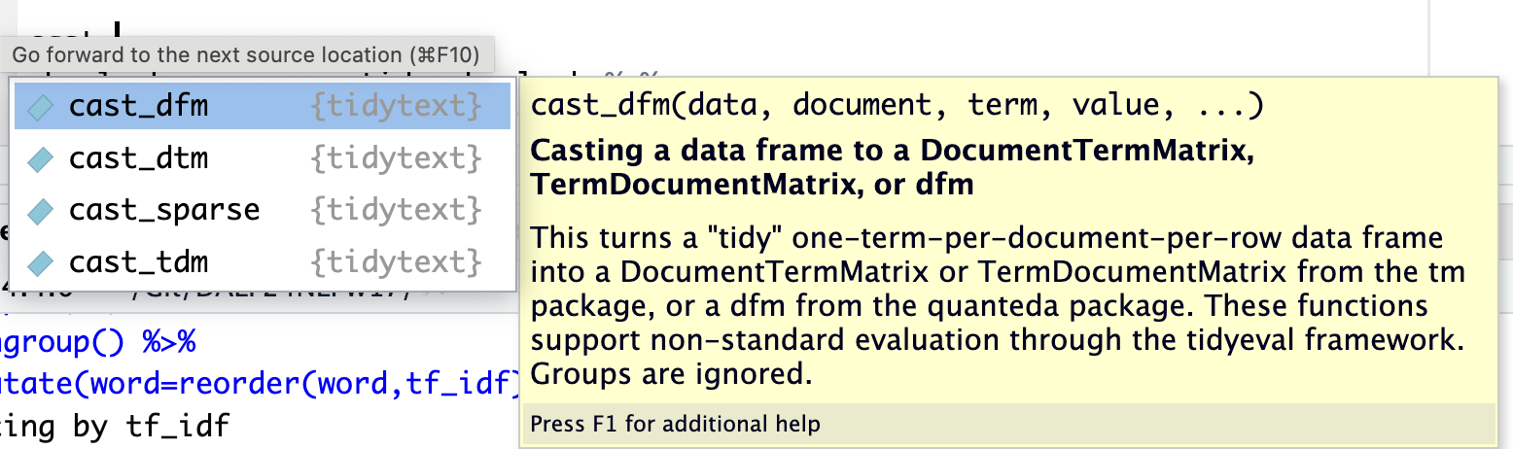
TOPIC MODELLING

Slide 15

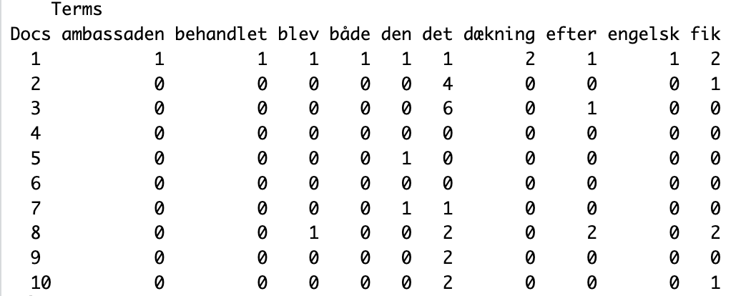
DTM- Quanteda

Slide 16
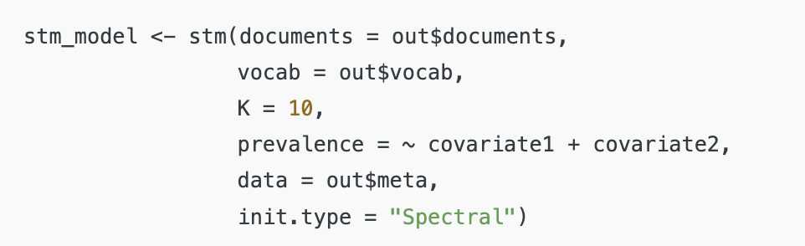
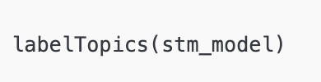
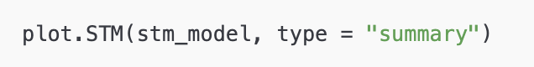
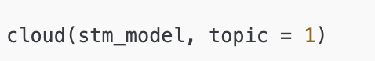
STM

Slide 17
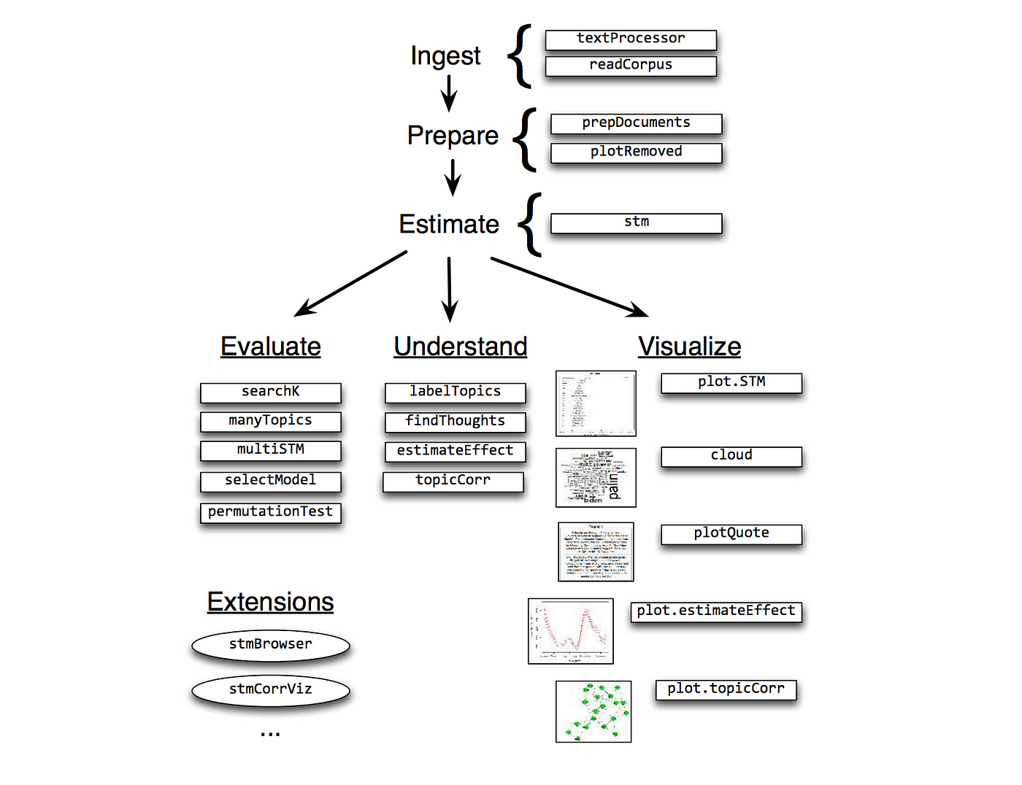
STM

Slide 18
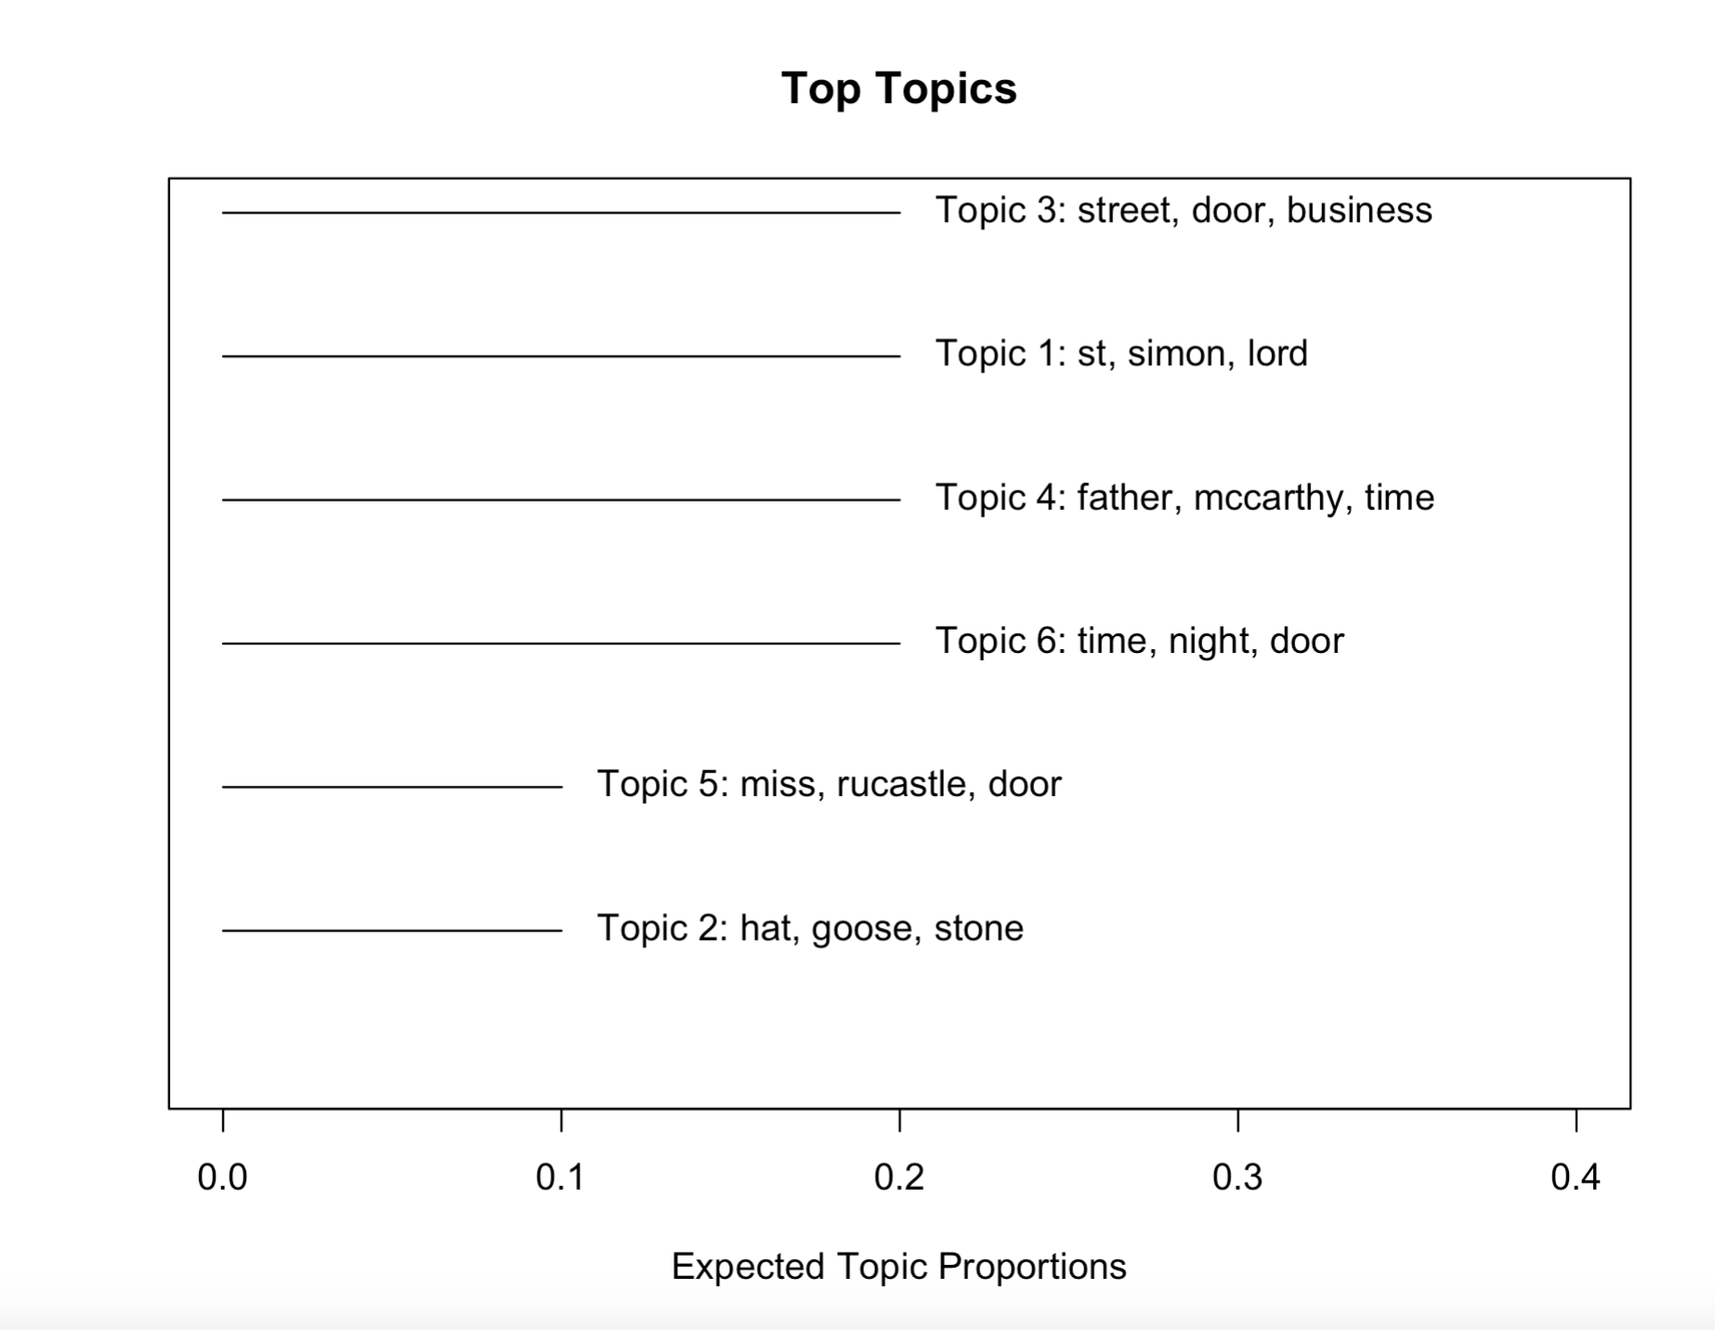

Slide 19
TIDY

Slide 20
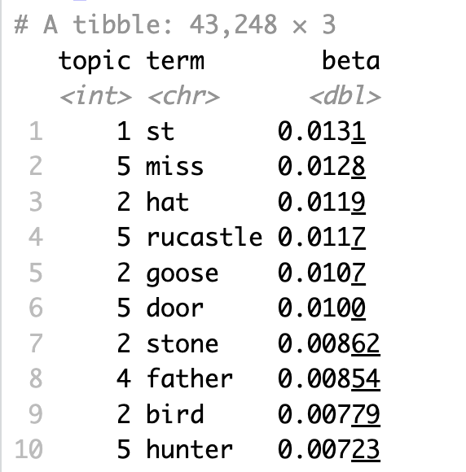
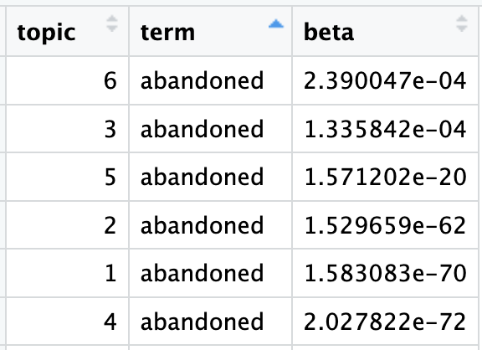
BETA
The tidytext package provides this method for extracting the per-topic-per-word probabilities, called β (“beta”), from he model.
the probability of that term being generated
from that topic.

Slide 21
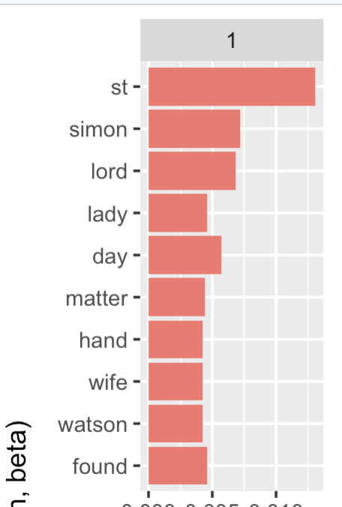
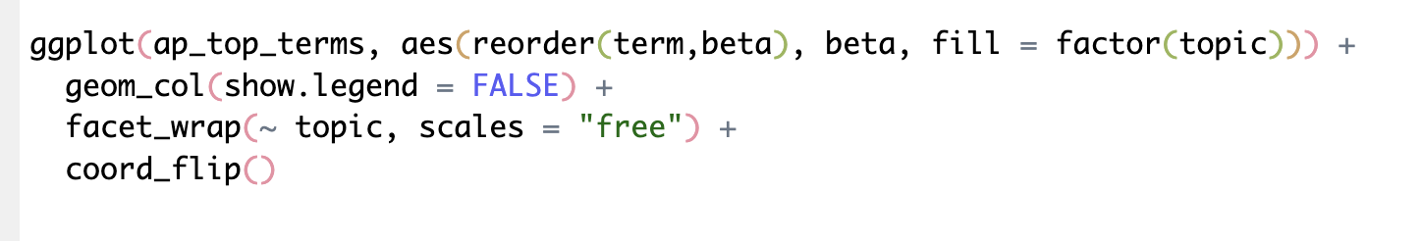
BETA
The tidytext package provides this method for extracting the per-topic-per-word probabilities, called β (“beta”), from the model.
the probability of that term being generated
from that topic.

Slide 22
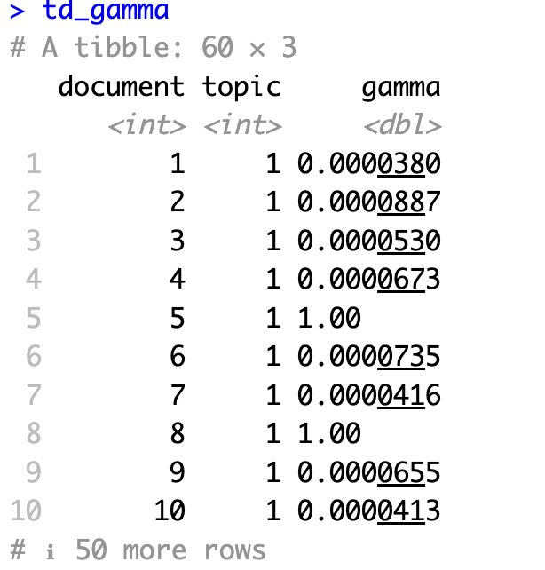
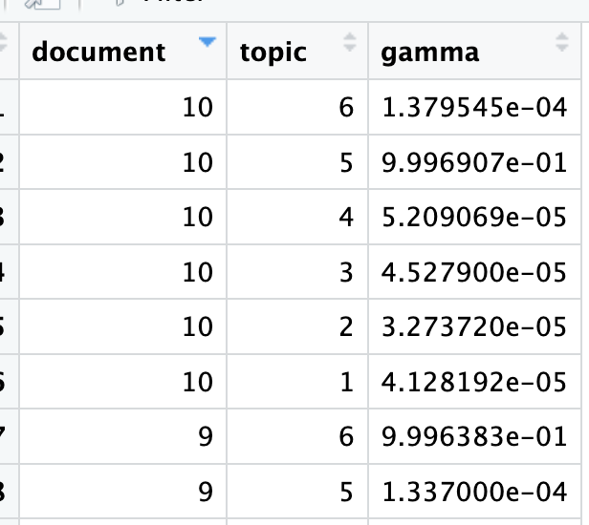
GAMMA
per-document-per-topic probabilities
Each of these values is an estimated proportion of words from that document that are
generated from that topic.
For example, the model estimates that only about 99% of the words in document 10 are generated from topic 5.

Slide 23
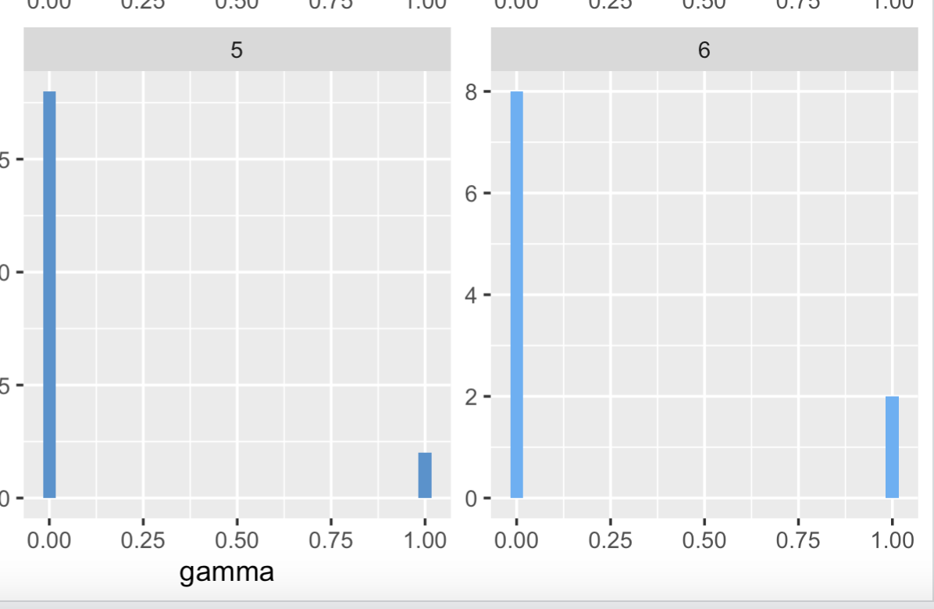
GAMMA
per-document-per-topic probabilities

